Slide 1











Understanding
Shakes and Shingles

Slide 2
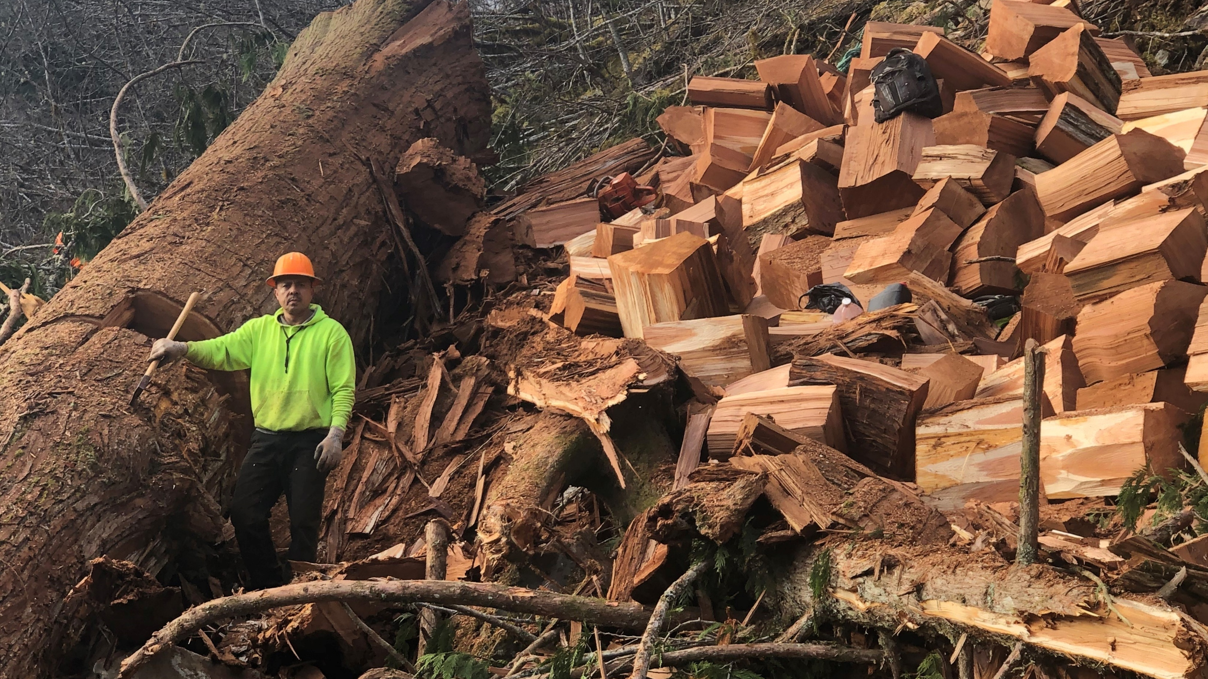
KNOWLEDGE IS WHERE IT BEGINS………

Slide 3
Quote It Right
Roof Questions
-Western Red Cedar or Alaskan Yellow Cedar? (White Cedar should not be used on a roof)
-Looking for 18” or 24”
-Perfection, Tapersawn, Handsplit or Royals? (R&Rs should not be used on a roof)
-Natural, CCA Treated or Fire Treated?
-How many squares?
-What is the exposure?
-How quick are you looking to start the job?
-Is there a specific mill you prefer?
-What are you using to ventilate the shakes/shingles?
-Cedar Breather, CedAir-Mat, Ventgrid

Slide 4
Quote It Right
Sidewall Questions
Western Red Cedar or Alaskan Yellow Cedar
Eastern White Cedar
Size - 18” or 24”
Grade - #1, #2, or Extra
Finish – Natural, Primed, or Pre-finished
Semi-Trans, Semi-Solid, Solid
Stock Color or Custom
Coats – 1 coat, Primer +1 or Primer +2
How many square?
What is the exposure?
How quickly do you need them?
Are you using a rainscreen?
Slicker, Mort-Air, Hydro-Gap, or Vent Grid
Size – 16” only
Grade - Extra, Clear, 2nd Clears
Finish – Natural, Primed, or Pre-finished
Stock Color or Custom
Coats – 1 coat or 2 coat
How many square?
What is the exposure?
How quickly do you need them?
Are you using a rainscreen?
Slicker, Mort-Air, Hydro-Gap, or Vent Grid

Slide 5
Product | Bundles per Square | Exposure | Recommend Maximum Exposure
Western Red Cedar
16" Fivex | 4 | 5" | 5"
18" Perfection | 4 | 5.5" | 5.5"
18" Tapersawn | 5 | 7.5" | 7.5"
18" Hand Split (9/9 pack) | 5 | 10" | 7.5"
18" Hand Split (12/12 pack) | 5 | 7.5" | 7.5"
24" Royal | 4 | 7.5" | 7.5"
24" Tapersawn | 5 | 10" | 10"
24" Hand Split | 5 | 10” | 10"
18" R&R (Primed, Grooved or Natural) | 1 box | 14" | 7”
24" R&R (Primed, Grooved or Natural) | 4 box | 8" | 10"
18" Barn Shake (Sidewall) | 4 | 14" | 7"
Alaskan Yellow Cedar
18" Perfection | 4 | 5.5" | 5.5"
18" Tapersawn | 5 | 7.5" | 7.5"
24" Royal | 4 | 7.5" | 7.5"
24" Tapersawn | 5 | 10" | 10"
18" R&R | 1 box | 14" | 7"
White Cedar
16" R&R and Regular | 4 | 5" | 5"

Slide 6
Converting Exposures
Figuring bundle quantities when changing exposures:
Take the suggested exposure (above) divide it by the desired exposure and
multiply that by the suggested exposures bundle count.
Example: 20 square of 18” WRC Tapersawn @ a 5.5” exposure = 136 bundles
7.5 divided by 5.5 = 1.36 multiply by 5 = 6.8 bundles to cover 1 square

Slide 7
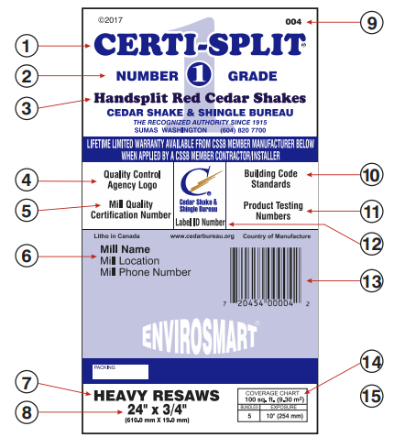
How to read a Label
The “Certi” Brand Name – Your Quality Assurance
Product Grade
Product Type
Independent, 3rd Party, Quality Control Agency
This Number Shows Compliance with Total Quality Manufacturing System
Mill Name, Location and Phone Number
Industry Product Description
Product Dimensions
Cedar Bureau Label Number
Building Code Compliance Numbers
Product Performance Tests Passed
Label Identification Number
UPC Code
Coverage Chart and Recommended Exposure
Application Instructions on Reverse Side

Slide 8
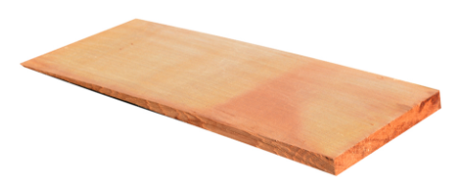
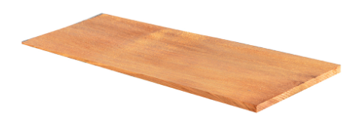
Certi-Sawn Tapersawn Shakes
How sell vs. Perfections
Both installed at 5 ½” exposure makes the Tapersawns $75-$80 more per square
Labor at $800.00+ per square, $75 - $80 = 7-8% more per square
About $3000.00 more on a 40 square roof
Everyone makes more $. The home owner gets 2x the wood. Win Win.

Slide 9
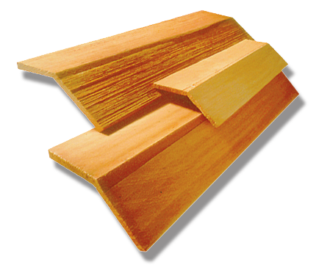
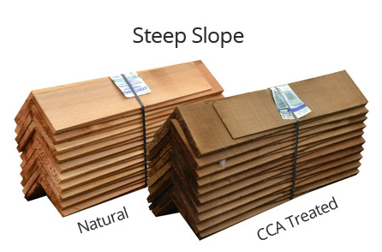
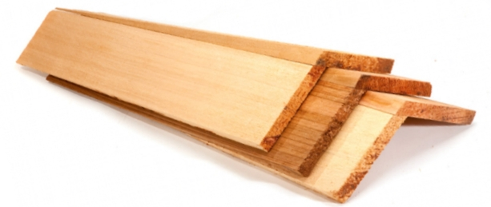
Hip or Ridge
Hip or Ridge Questions
Hip or Ridge?
What length?
What exposure?
Inside measurement?
What pitch?

Slide 10
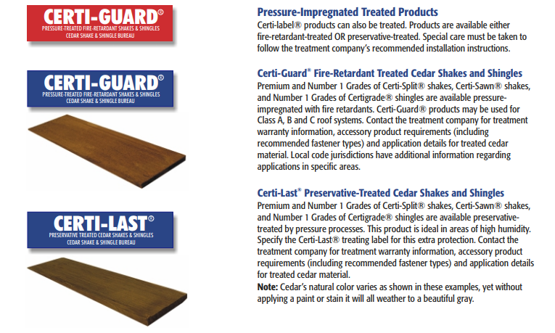
Treatment Options

Slide 11
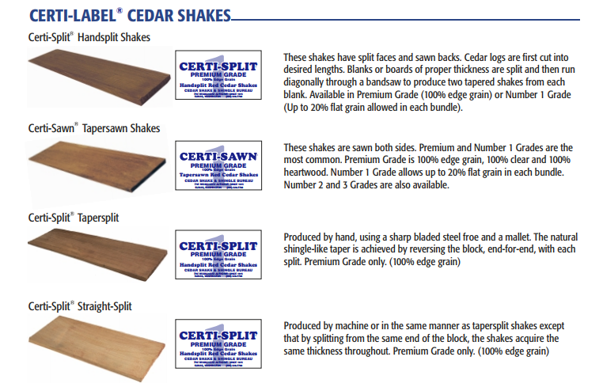

Slide 12
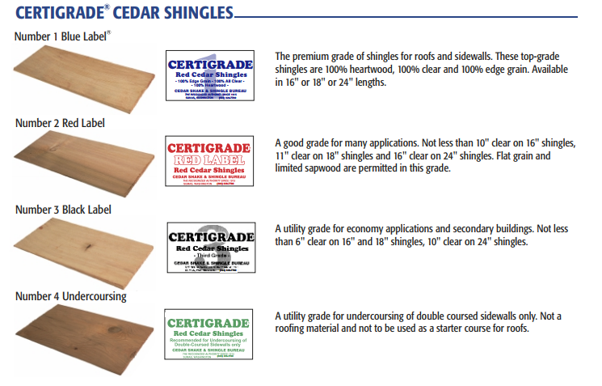

Slide 13
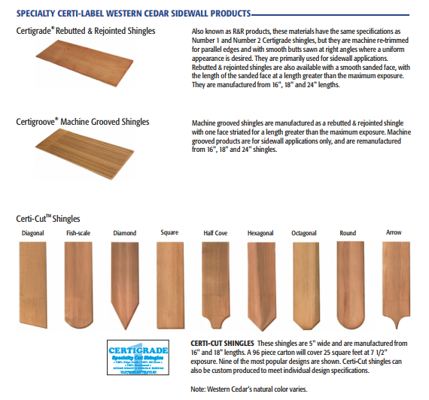
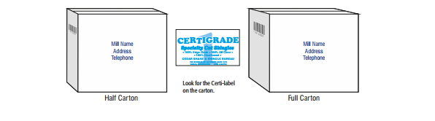

Slide 14


Underlayments
Felt
Skip Sheathing
Strapping
*All cedar warranties will be void if Ice & Water Shield
are applied to entire roof deck.

Slide 15


Slide 16
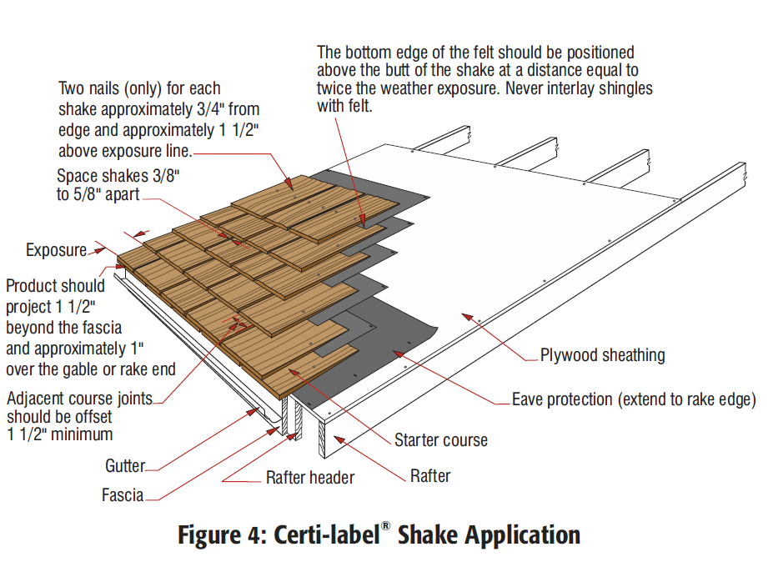
Figuring Felt
CSSB Recommendation, “Felt should be positioned above the butt of the shake at a distance equal to twice the exposure.”
Example:
10-inch exposure application on a 50 Sq. Roof
(50square = 5,000 Sq.Ft.)
Exposure Factor: Exposure/12, (10/12 = 8.333)
Total Square Footage divided by the Exposure Factor
5,000 / .8334 = 6,000 L/F of Felt = 84 rolls**
**72 L/F of Split Felt per roll **

Slide 17
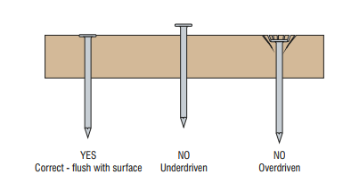
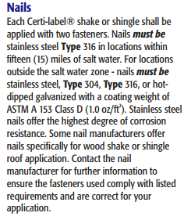
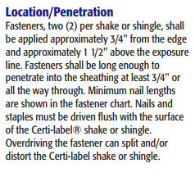
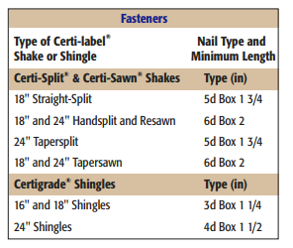
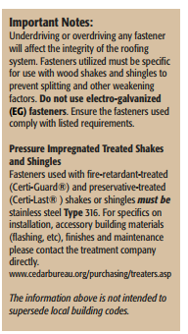
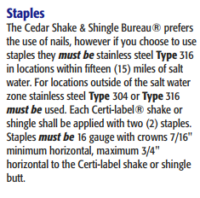

Slide 18
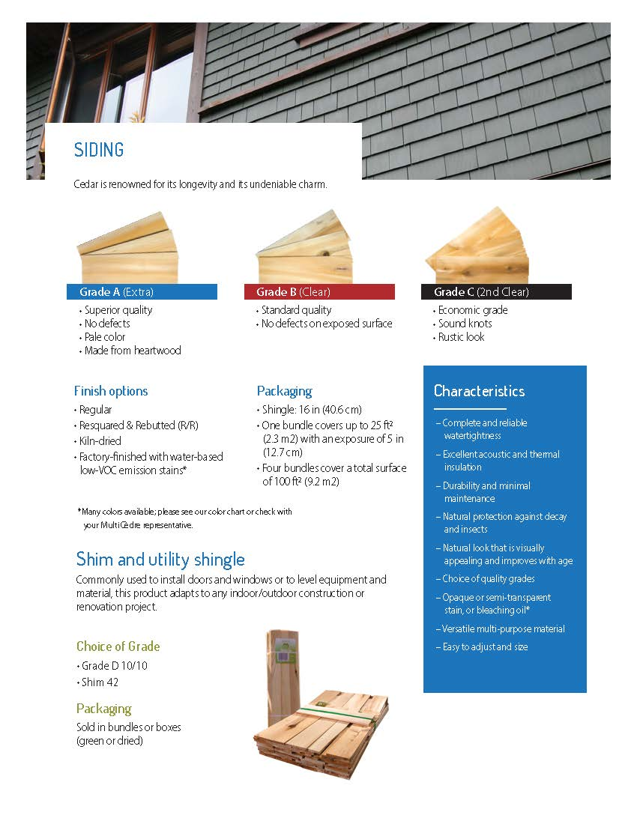

Slide 19
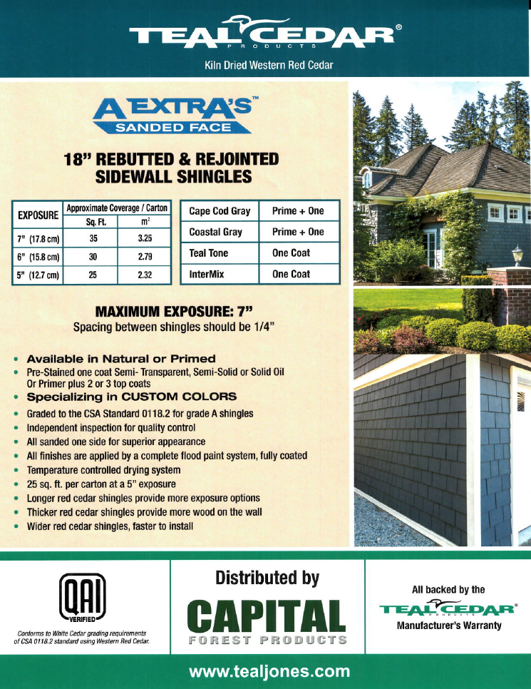

Slide 20

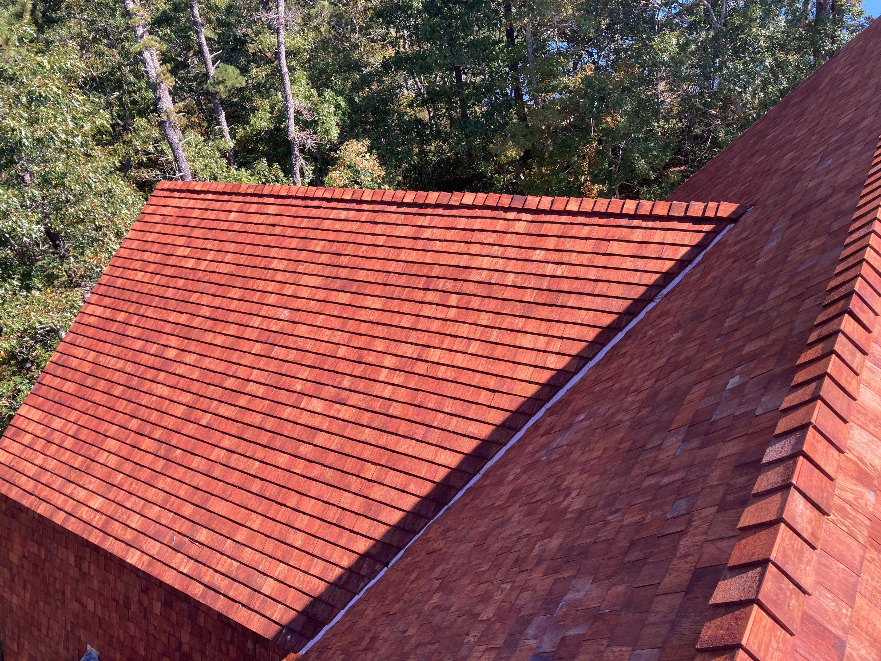
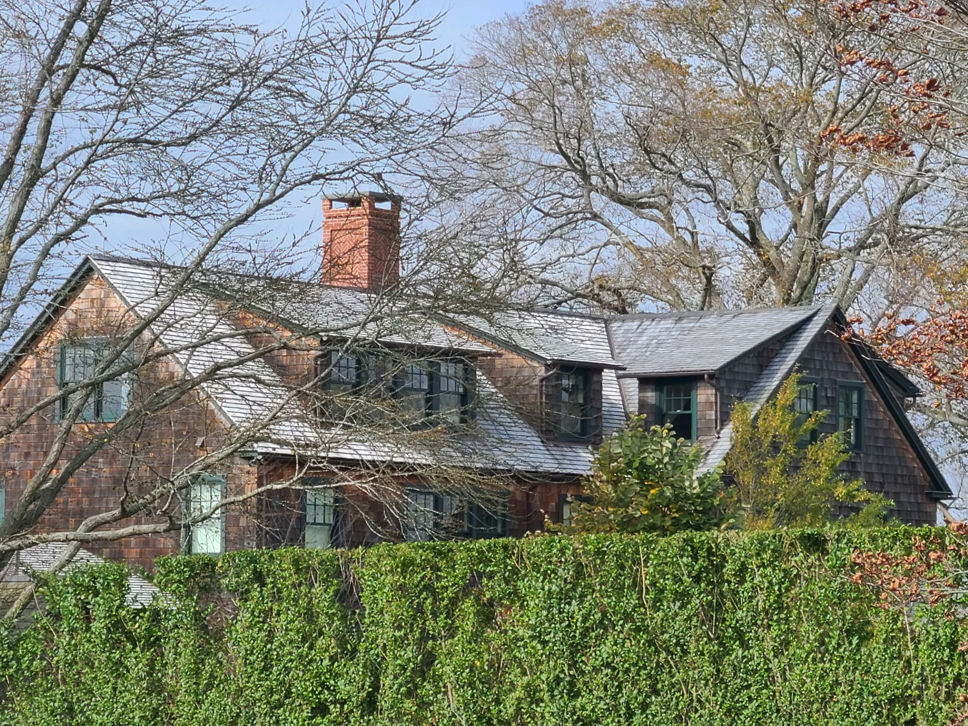
NEW
AGED

Slide 21

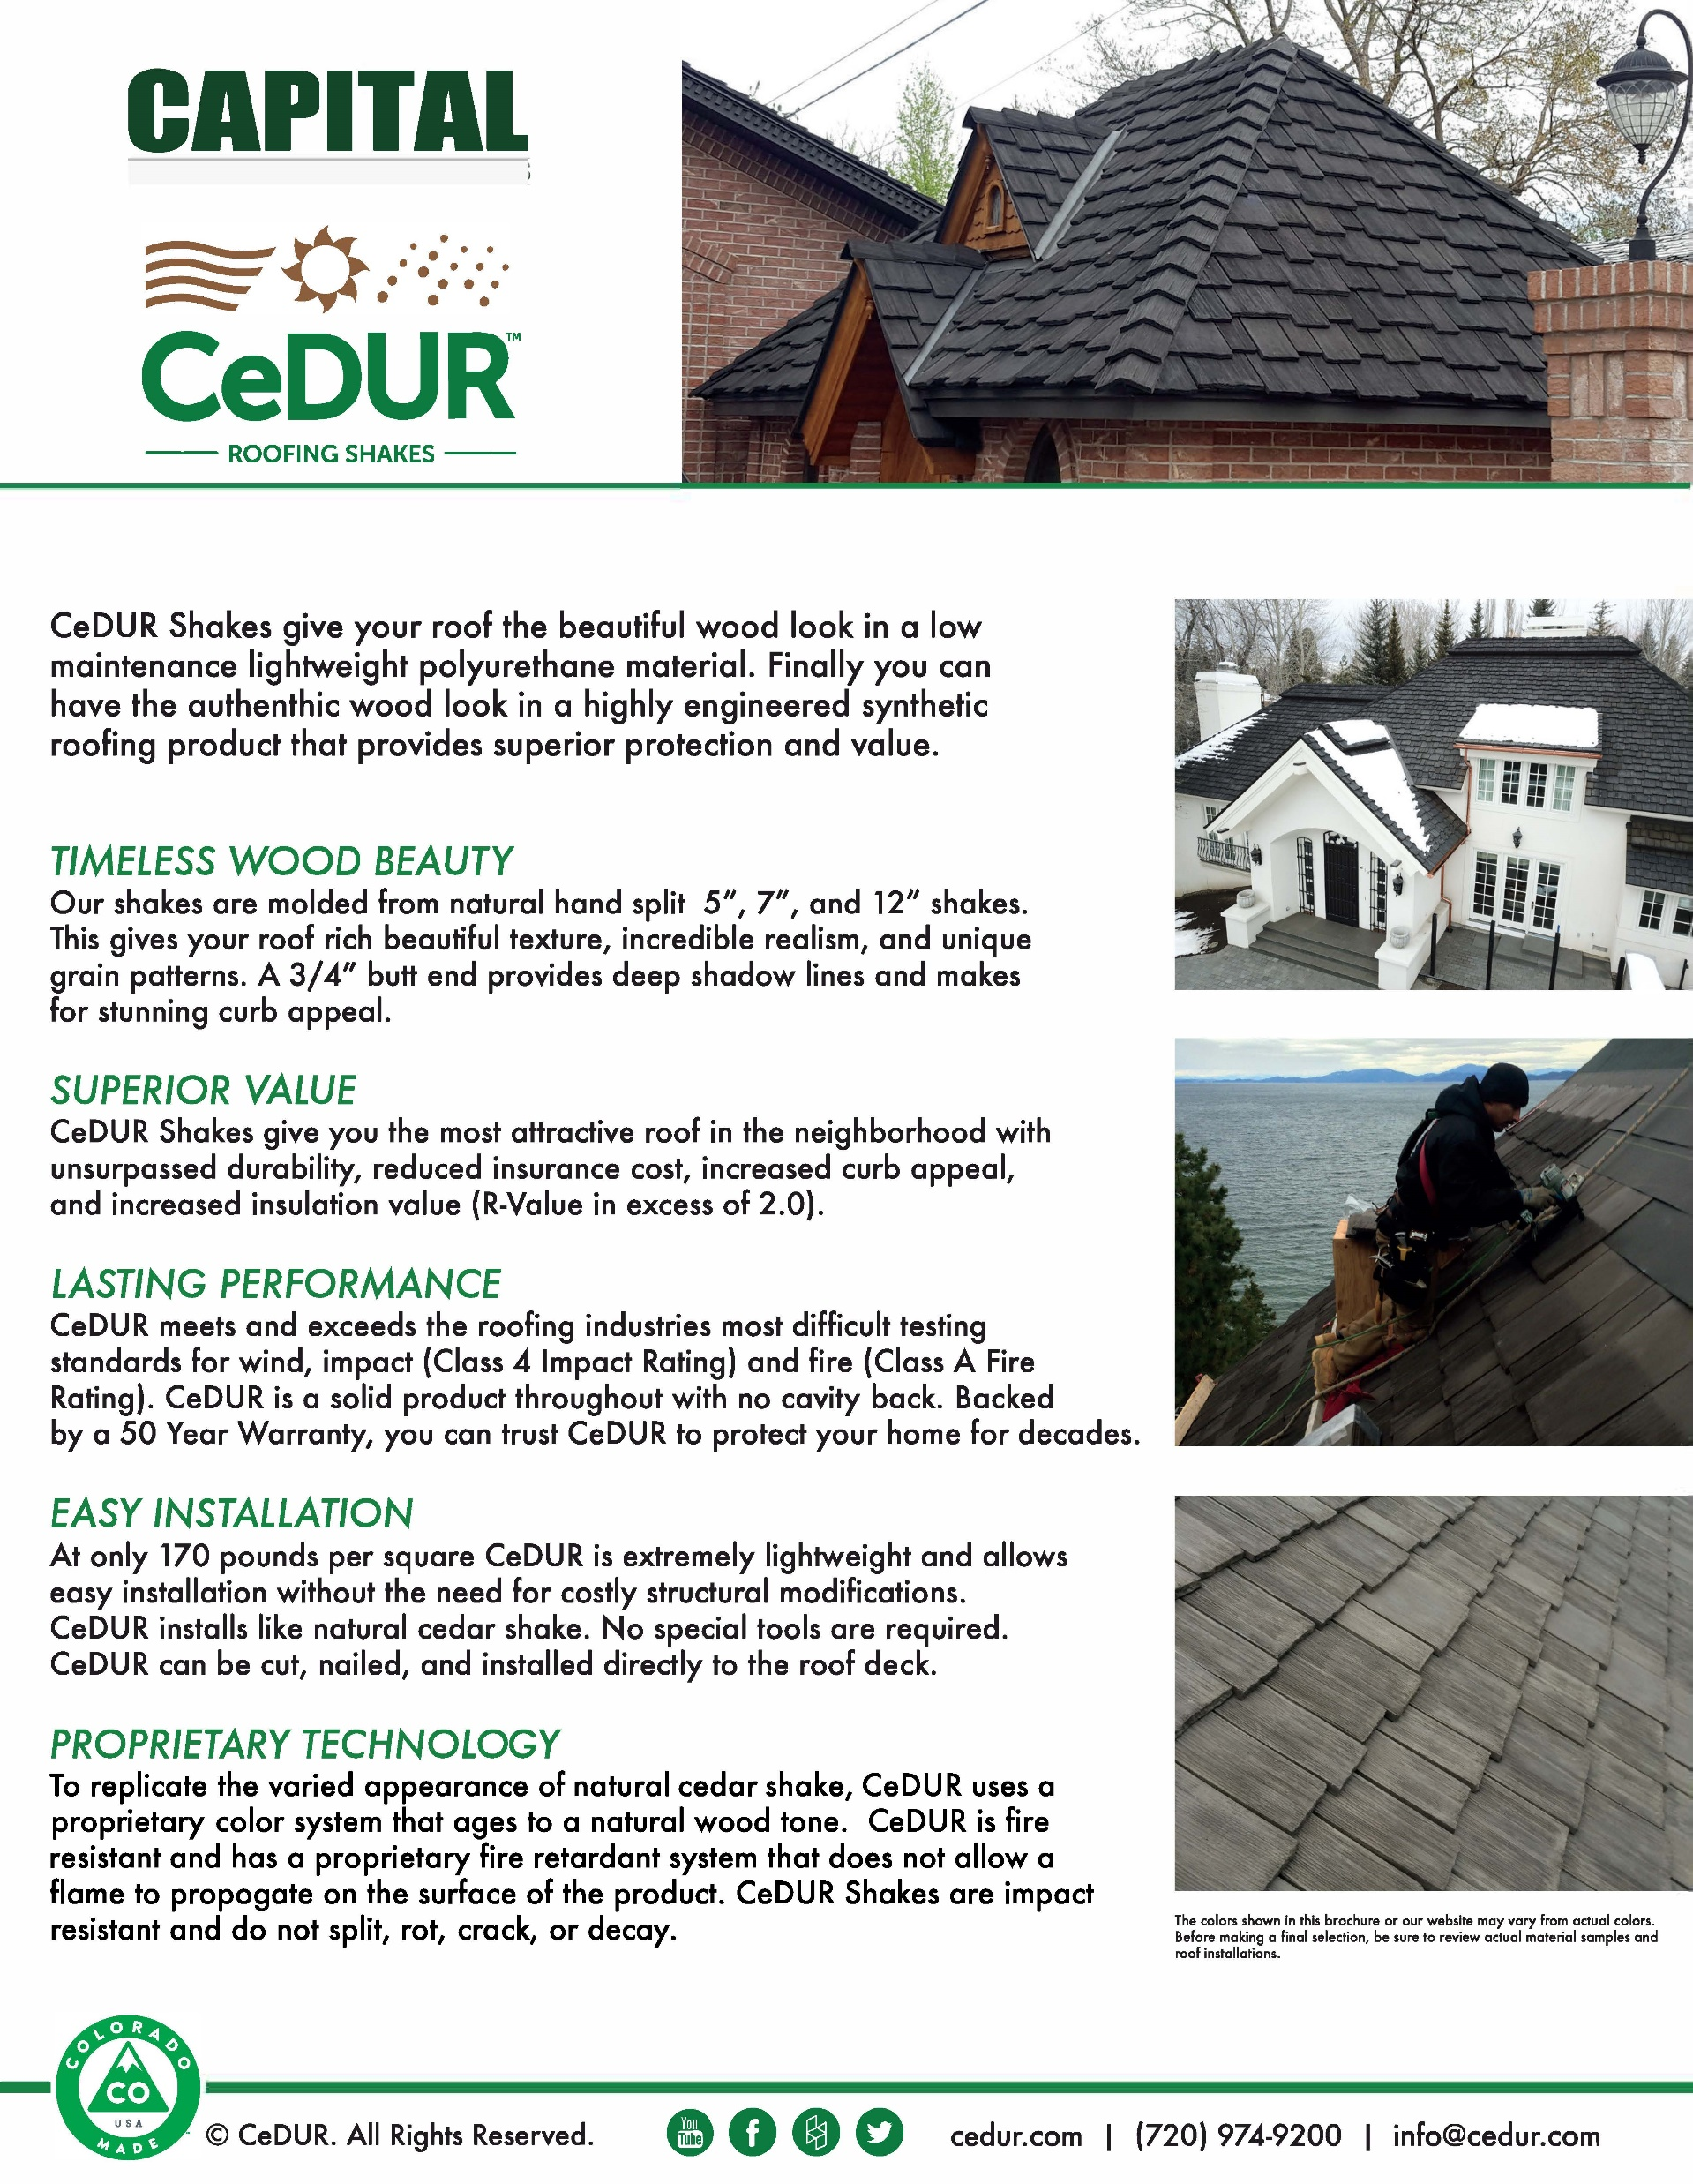

Slide 22
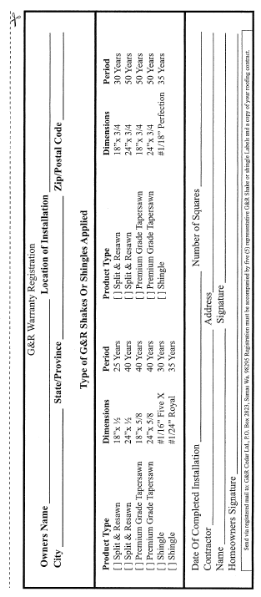
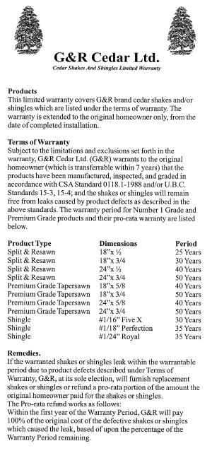
Warranties
In most cases, a warranty application must be filed to validate the warranty.

Slide 23
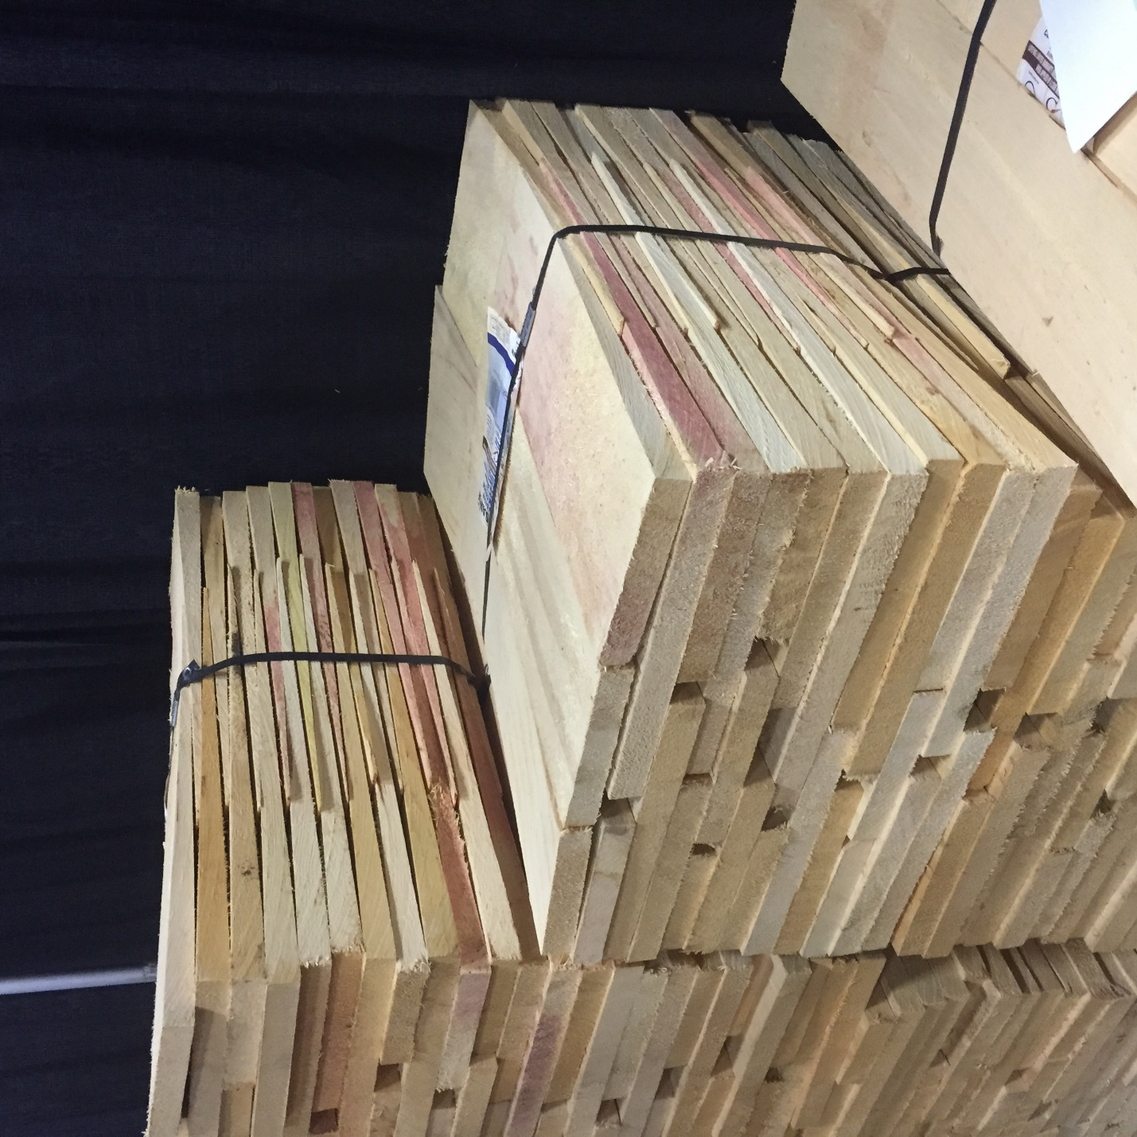
Pink Stain

Slide 24
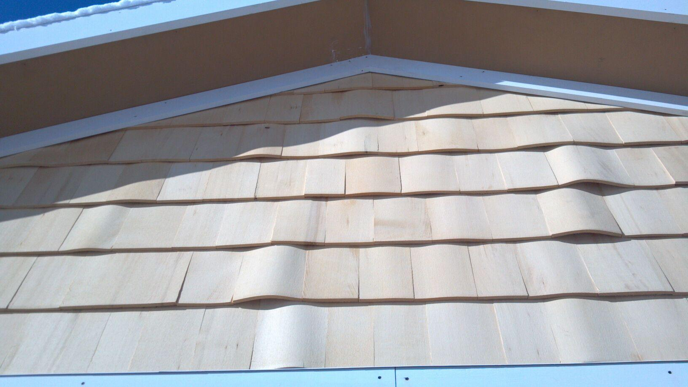
Buckling

Slide 25
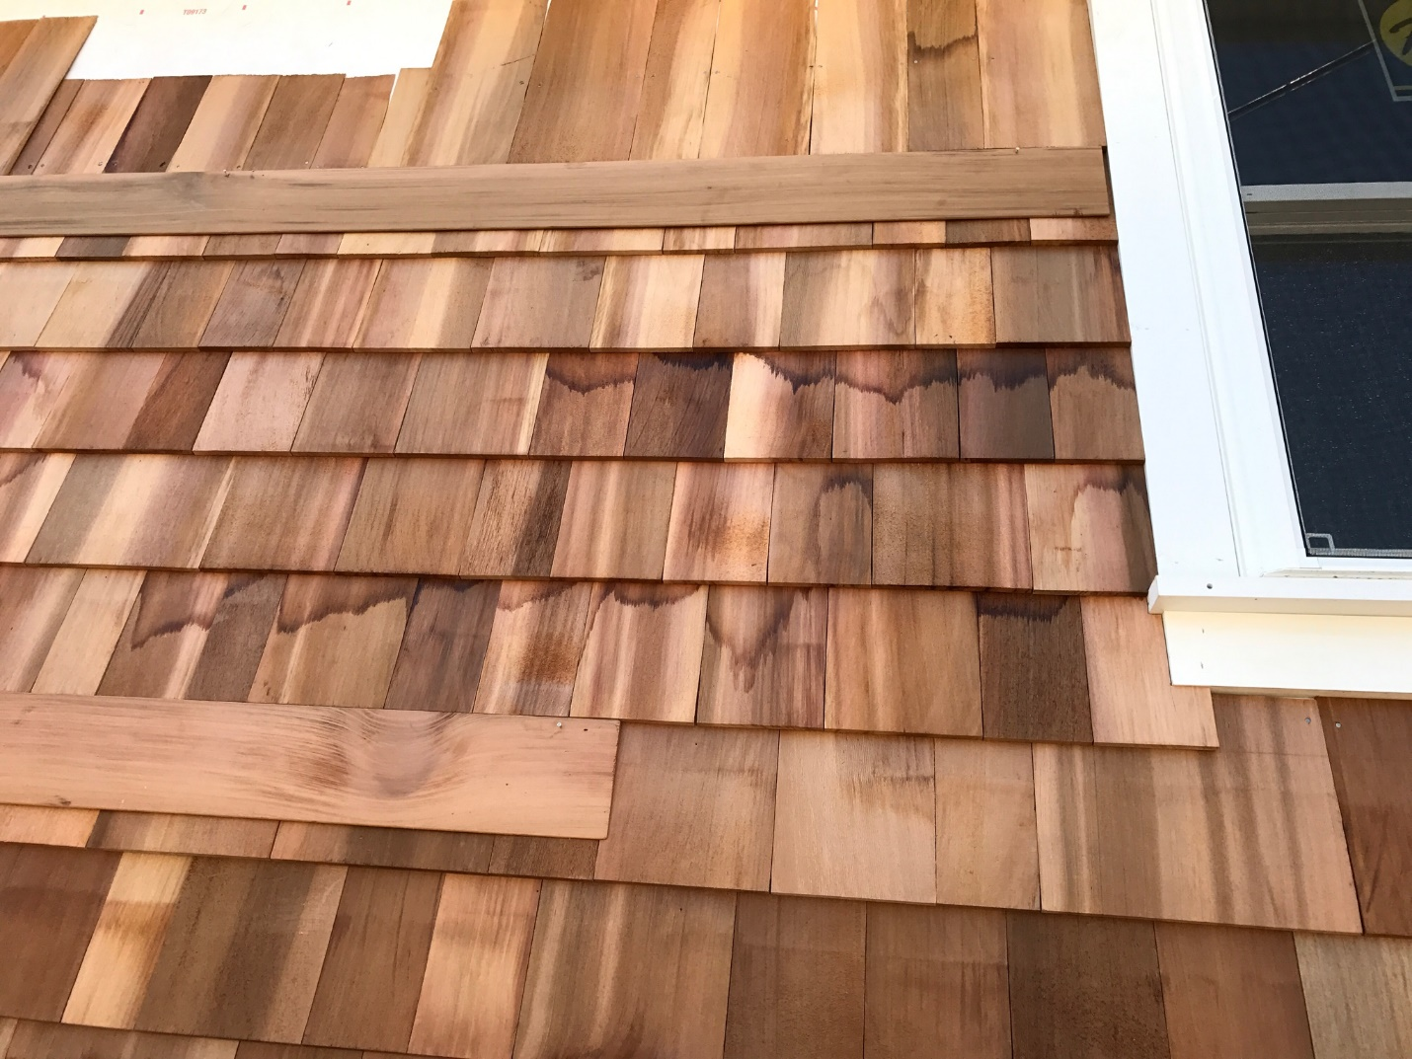
Cedar Bleed

